Slide 1
Unit I Understanding Cloud Computing

Slide 2
Origins and Influences
A Brief History
"If computers of the kind I have advocated become the computers of the future, then computing may someday be organized as a public utility just as the telephone system is a public utility... The computer utility could become the basis of a new and important industry.“
John McCarthy , 1961

Slide 3
"As of now, computer networks are still in their infancy, but as they grow up and become sophisticated, we will probably see the spread of 'computer utilities' ...".
Leonard Kleinrock, 1969, ARPANET.
forms of Internet-based computer utilities
search engines (Yahoo!, Google),
e-mail services (Hotmail, Gmail),
open publishing platforms (MySpace, Facebook, YouTube),
other types of social media (Twitter, LinkedIn)
and Amazon Web Services (AWS) platform (storage, computing resources, and business functionality)
It wasn't until 2006 that the term "cloud computing" emerged in the commercial arena. It was during this time that Amazon launched its Elastic Compute Cloud (EC2) services that enabled organizations to "lease" computing capacity and processing power to run their enterprise applications.
Google Apps also began providing browser-based enterprise applications in the same year, and three years later, the Google App Engine became another historic milestone.

Slide 4
Definitions
"...a style of computing in which scalable and elastic IT-enabled capabilities are delivered as a service to external customers using Internet technologies.“
"...a standardized IT capability (services, software, or infrastructure) delivered via Internet technologies in a pay-per-use, self-service way.“

Slide 5
"Cloud computing is a model for enabling ubiquitous, convenient, on-demand network access to a shared pool of configurable computing resources (e.g., networks, servers, storage, applications, and services) that can be rapidly provisioned and released with minimal management effort or service provider interaction. This cloud model is composed of five essential characteristics, three service models, and four deployment models.“
"Cloud computing is a specialized form of distributed computing that introduces utilization models for remotely provisioning scalable and measured resources."

Slide 6
Business Drivers
Capacity Planning
Capacity planning is the process of determining and fulfilling future demands of an organization's IT resources, products, and services.
Different capacity planning strategies exist:
Lead Strategy - adding capacity to an IT resource in anticipation of demand
Lag Strategy - adding capacity when the IT resource reaches its full capacity
Match Strategy - adding IT resource capacity in small increments, as demand increases
A discrepancy between the capacity of an IT resource and its demand can result in a system becoming either inefficient (over-provisioning) or unable to fulfil user needs (under-provisioning). Capacity planning is focused on minimizing this discrepancy to achieve predictable efficiency and performance.
Capacity Planning can be challenging because it requires estimating usage load fluctuations.
Notes:
One of the biggest advantages cloud computing offers is the elastic usage of resources. elasticity is only good if your implementation strategy is good. Even though increased capacity can be easily acquired, it is important to know what your company is currently using and will need in the future. With the cloud, the possibility of elasticity is ever present but it is up to the user to know how to use that power effectively. Cloud models can seem appealing because they offer lower cost alternatives to previous structures.

Slide 7
Cost Reduction
A direct alignment between IT costs and business performance can be difficult to maintain.
Two costs need to be accounted for: the cost of acquiring new infrastructure, and the
cost of its ongoing ownership.
infrastructure-related operating overhead include the following:
• technical personnel required to keep the environment operational
• upgrades and patches that introduce additional testing and deployment cycles
• utility bills and capital expense investments for power and cooling
• security and access control measures that need to be maintained and enforced to
protect infrastructure resources
• administrative and accounts staff that may be required to keep track of licenses
and support arrangements

Slide 8
Organizational Agility
Businesses need the ability to adapt and evolve to successfully face change caused by both internal and external factors. Organizational agility is the measure of an organization's responsiveness to change.
An IT enterprise often needs to respond to business change by scaling its IT resources beyond the scope of what was previously predicted or planned for.

Slide 9
Technology Innovations
Clustering
A cluster is a group of independent IT resources that are interconnected and work as a single system.
hardware clustering is that its component systems have reasonably identical hardware and operating systems to provide similar performance levels when one failed component is to be replaced by another.
Component devices that form a cluster are kept in synchronization through dedicated, high-speed communication links.
Grid Computing
A computing grid (or "computational grid") provides a platform in which computing resources are organized into one or more logical pools. These pools are collectively coordinated to provide a high performance distributed grid, sometimes referred to as a "super virtual computer."
Grid computing differs from clustering in that grid systems are much more loosely coupled and distributed. As a result, grid computing systems can involve computing resources that are heterogeneous and geographically dispersed, which is generally not possible with cluster computing-based systems.

Slide 10
Virtualization
Virtualization represents a technology platform used for the creation of virtual instances of IT resources. A layer of virtualization software allows physical IT resources to provide multiple virtual images of themselves so that their underlying processing capabilities can be shared by multiple users.
Technology Innovations vs. Enabling Technologies
cloud-enabling technologies
Broadband Networks and Internet Architecture
Data Center Technology
(Modern) Virtualization Technology
Web Technology
Multitenant Technology
Service Technology
Each of these cloud-enabling technologies existed in some form prior to the formal advent of cloud computing. Some were refined further, and on occasion even redefined, as a result of the subsequent evolution of cloud computing.

Slide 11
Basic Concepts and Terminology
Cloud
IT Resource
On-Premise
Scaling
Cloud Service
Cloud Service Consumer

Slide 12
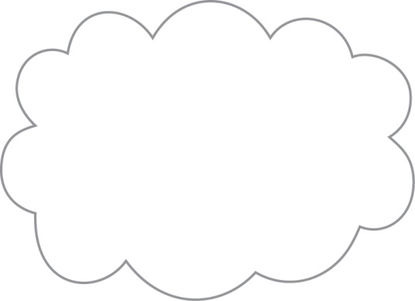
Cloud
A cloud refers to a distinct IT environment that is designed for the purpose of remotely provisioning scalable and measured IT resources.
The term originated from Internet which is a network of networks providing remote access to a set of decentralized IT resources.
It is important to distinguish the term "cloud" and the cloud symbol from the Internet. As a specific environment used to remotely provision IT resources, a cloud has a finite boundary. There are many individual clouds that are accessible via the Internet.
Whereas the Internet provides open access to many Web-based IT resources, a cloud is typically privately owned and offers access to IT resources that is metered.
Figure 1 - The symbol used to denote the boundary of a cloud environment.

Slide 13
Much of the Internet is dedicated to the access of content-based IT resources published via the World Wide Web. IT resources provided by cloud environments, on the other hand, are dedicated to supplying back-end processing capabilities and user-based access to these capabilities. Another key distinction is that it is not necessary for clouds to be Web-based even if they are commonly based on Internet protocols and technologies. Protocols refer to standards and methods that allow computers to communicate with each other in a pre-defined and structured manner. A cloud can be based on the use of any protocols that allow for the remote access to its IT resources.

Slide 14
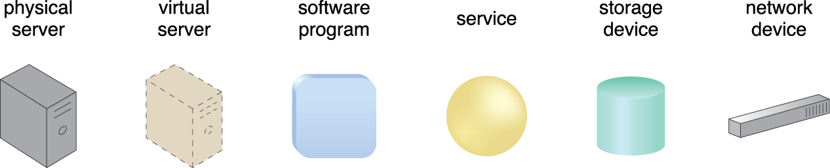
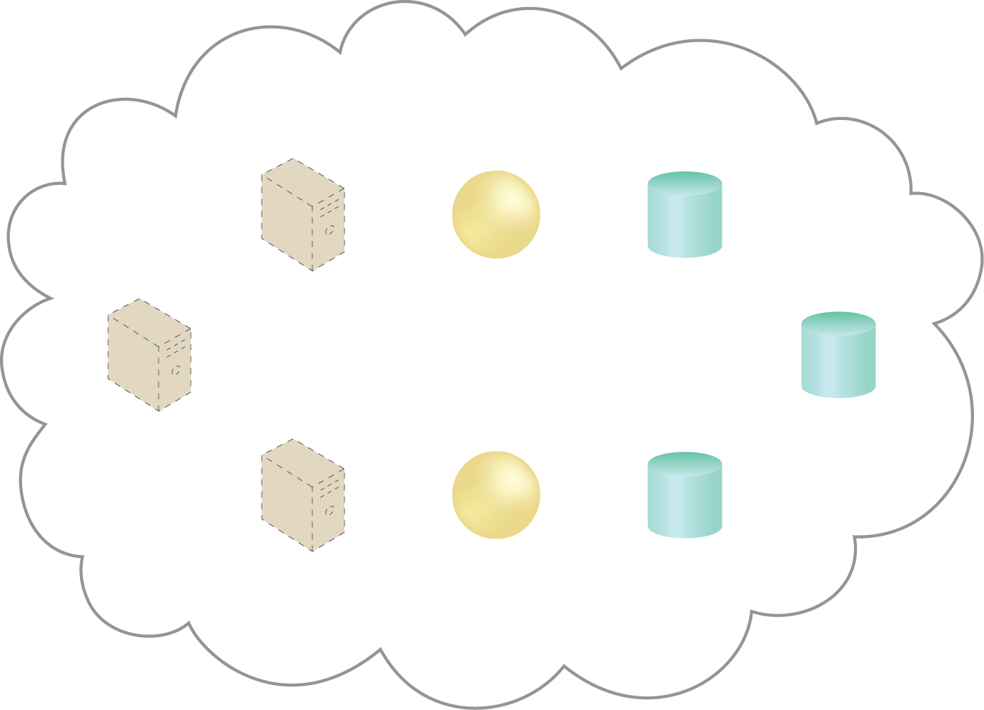
IT Resource

Slide 15
On-Premise
As a distinct and remotely accessible environment, a cloud represents an option for the deployment of IT resources. An IT resource that is hosted in a conventional IT enterprise within an organizational boundary (that does not specifi cally represent a cloud) is considered to be located on the premises of the IT enterprise, or on-premise for short.
In other words, the term “on-premise” is another way of stating “on the premises of a
controlled IT environment that is not cloud-based.” This term is used to qualify an IT
resource as an alternative to “cloud-based.” An IT resource that is on premisecannotbe cloud-based, and vice-versa.
Note the following key points:
• An on-premise IT resource can access and interact with a cloud-based IT resource.
• An on-premise IT resource can be moved to a cloud, thereby changing it to a
cloud-based IT resource.
• Redundant deployments of an IT resource can exist in both on-premise and cloudbased
Environments.

Slide 16
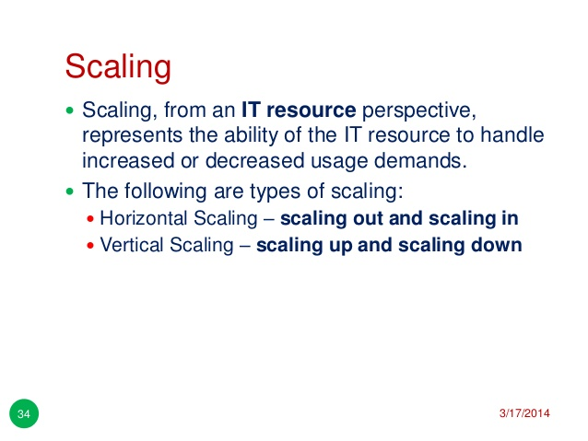

Slide 17
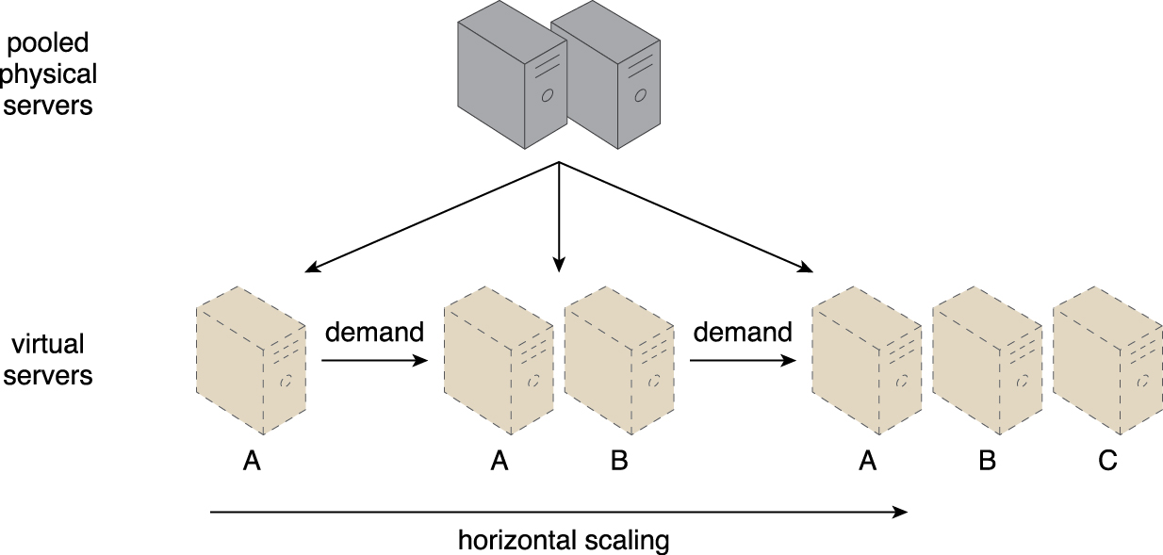
Horizontal Scaling
An IT resource (Virtual Server A) is scaled out by adding more of the same IT resources (Virtual Servers B and C).

Slide 18
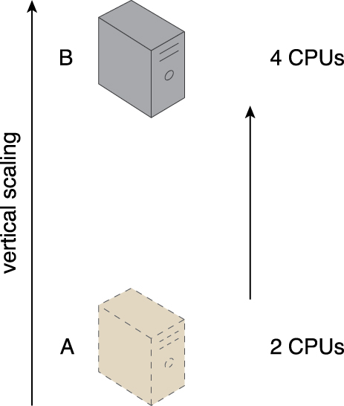
Vertical Scaling
An IT resource (a virtual server with two CPUs) is scaled up by replacing it with a more powerful IT resource with increased capacity for data storage
(a physical server with four CPUs).

Slide 19
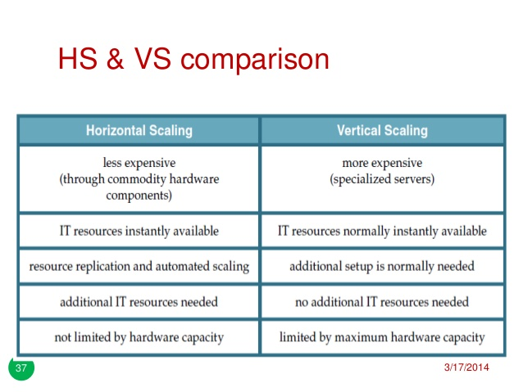

Slide 20
Cloud Service
A cloud service is any IT resource that is made remotely accessible via a cloud.
Although a cloud is a remotely accessible environment, not all IT resources residing within a cloud can be made available for remote access.
For example, a database or a physical server deployed within a cloud may only be accessible by other IT resources that are within the same cloud.
A software program with a published API may be deployed specifically to enable access by remote clients.
A cloud service can exist as a simple Web-based software program with a technical interface invoked via the use of a messaging protocol, or as a remote access point for administrative tools or larger environments and other IT resources

Slide 21
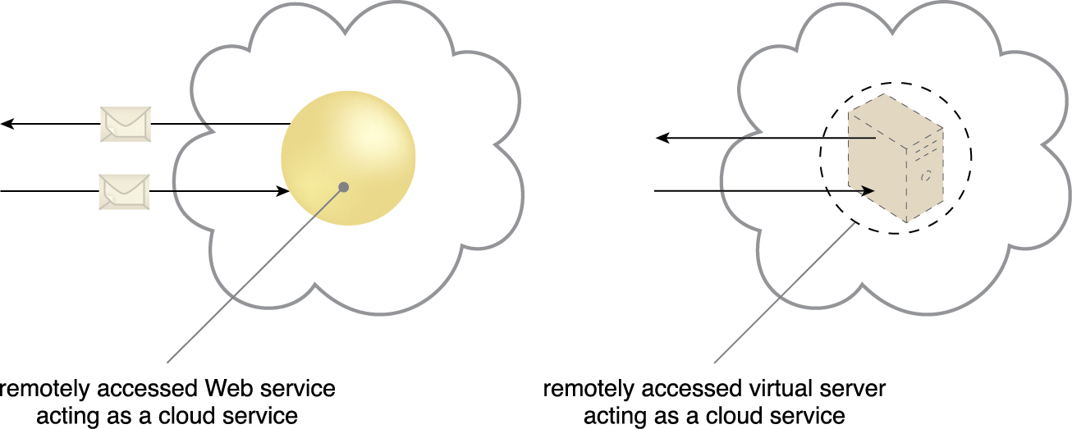
A cloud service with a published technical interface is being accessed by a consumer outside of the cloud (left).
A cloud service that exists as a virtual server is also being accessed from outside of the cloud’s boundary (right).
The cloud service on the left is likely being invoked by a consumer program that was designed to access the cloud service’s published technical interface.
The cloud service on the right may be accessed by a human user that has remotely logged on to the virtual server.

Slide 22
Cloud Consumers and Cloud Providers
The party that provides cloud-based IT resources is the cloud provider.
The party that uses cloud-based IT resources is the cloud consumer.

Slide 23
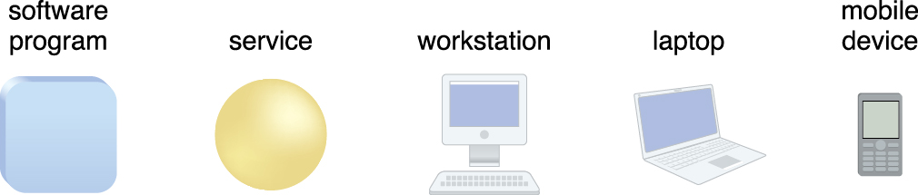
Cloud Service Consumer
The cloud service consumer is a temporary runtime role assumed by a software program when it accesses a cloud service.
Examples of cloud service consumers. Depending on the nature of a given
diagram, an artifact labeled as a cloud service consumer may be a software
program or a hardware device (in which case it is implied that it is running a
software program capable of acting as a cloud service consumer).

Slide 24
Examples of cloud service consumers. Depending on the nature of a given
diagram, an artifact labeled as a cloud service consumer may be a software
program or a hardware device (in which case it is implied that it is running a
software program capable of acting as a cloud service consumer).

Slide 25
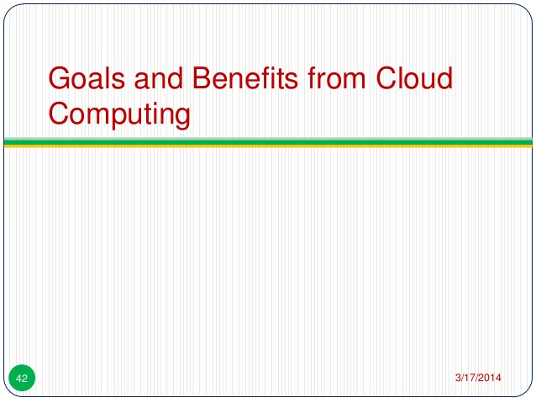

Slide 26
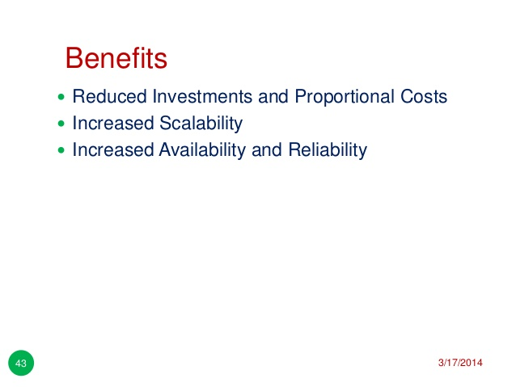

Slide 27
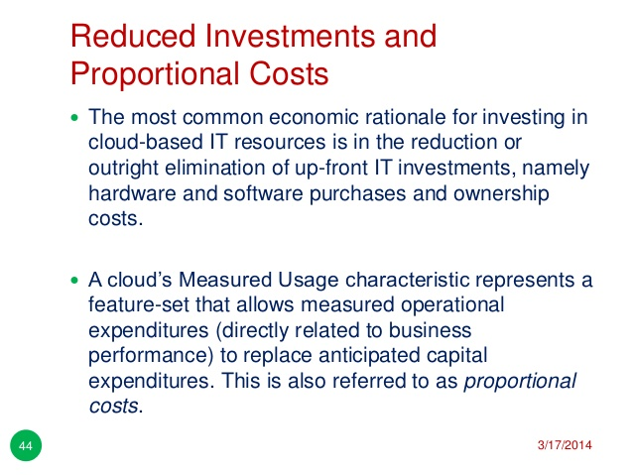

Slide 28
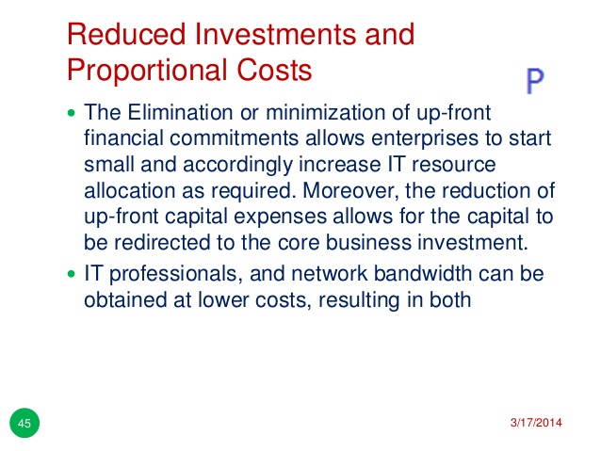

Slide 29
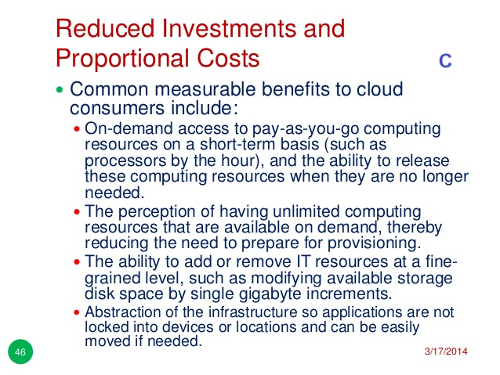

Slide 30
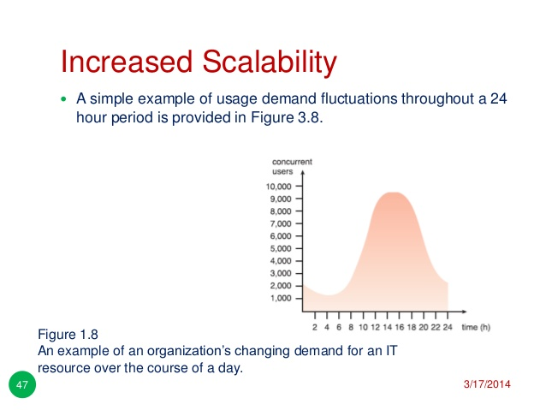

Slide 31
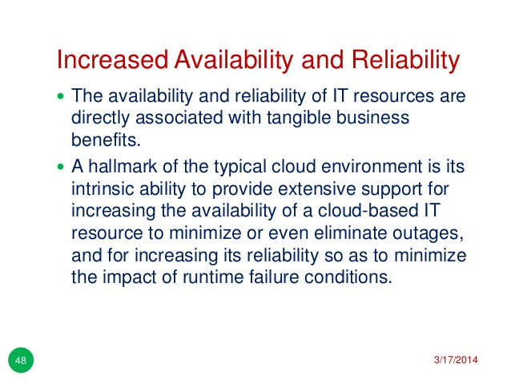

Slide 32
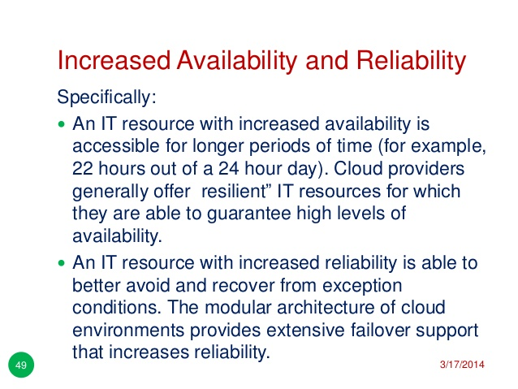

Slide 33
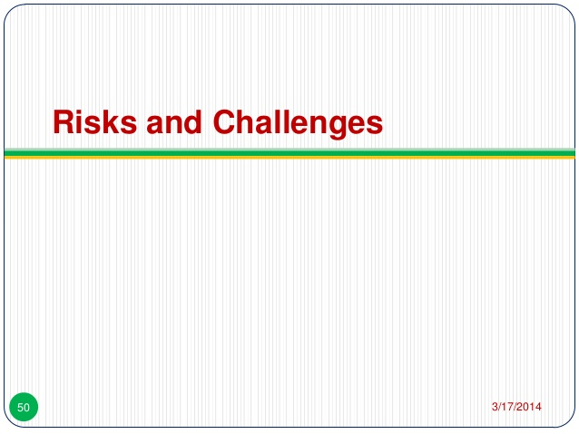

Slide 34
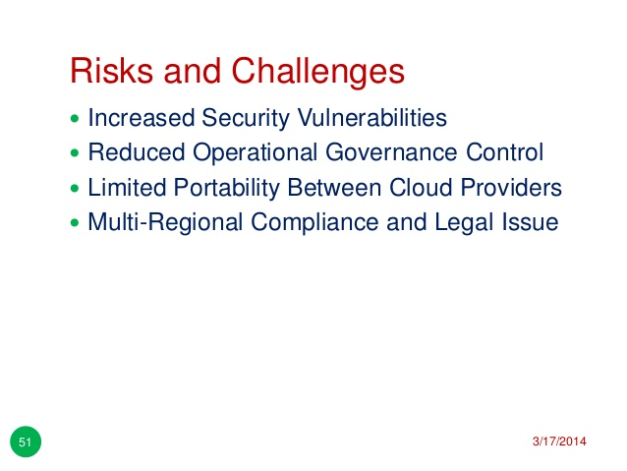

Slide 35
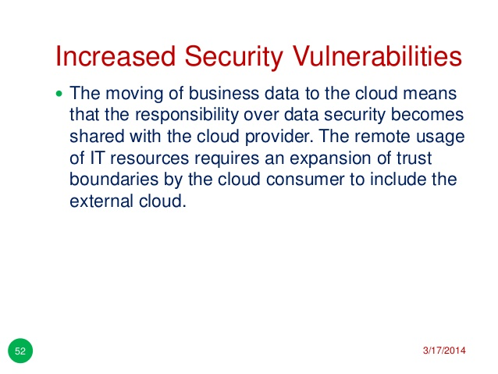

Slide 36
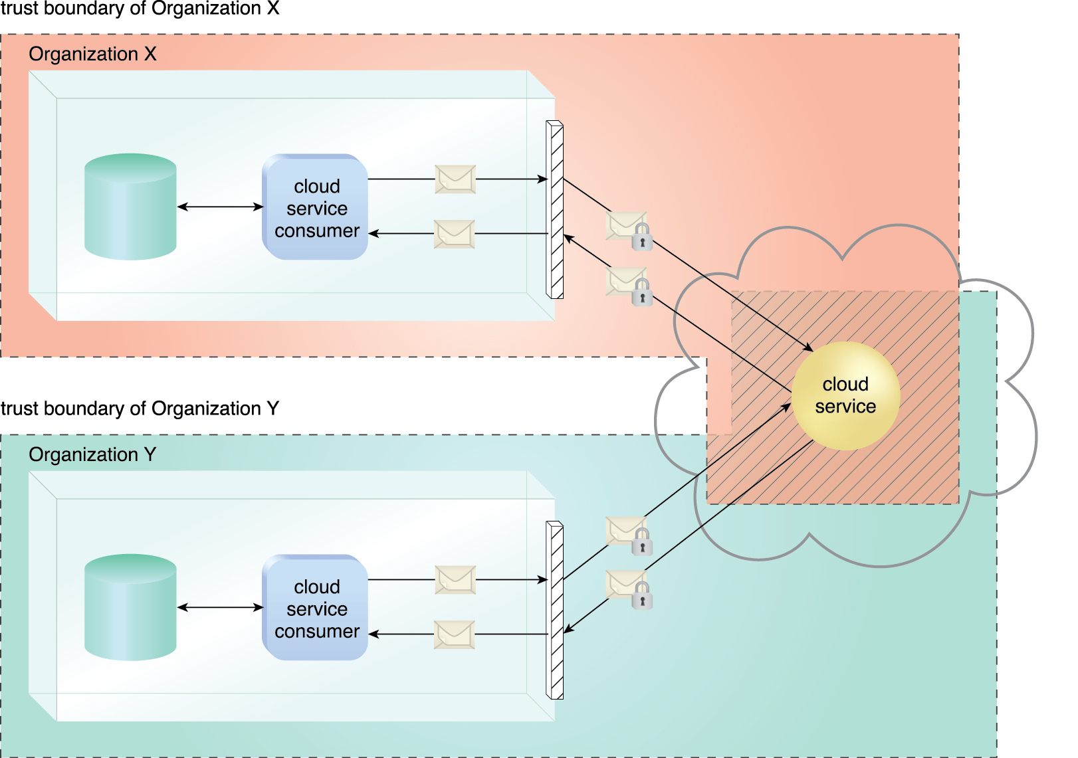
The shaded area with diagonal lines indicates the overlap of two organizations’ trust boundaries.

Slide 37
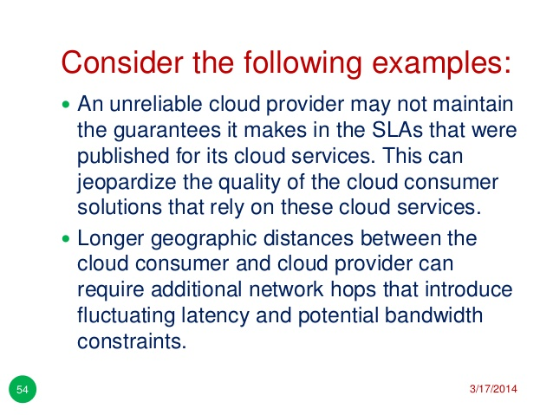

Slide 38
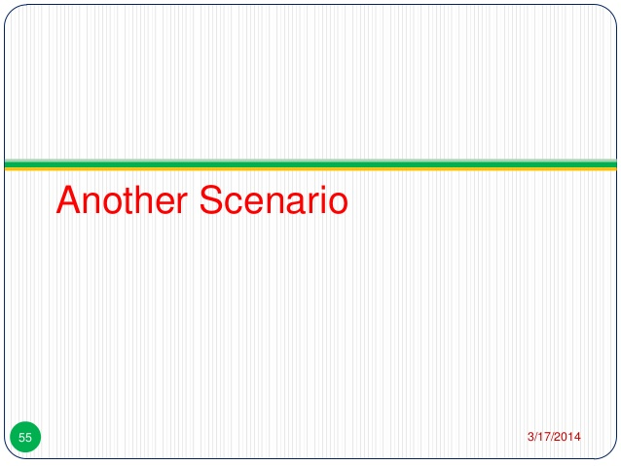
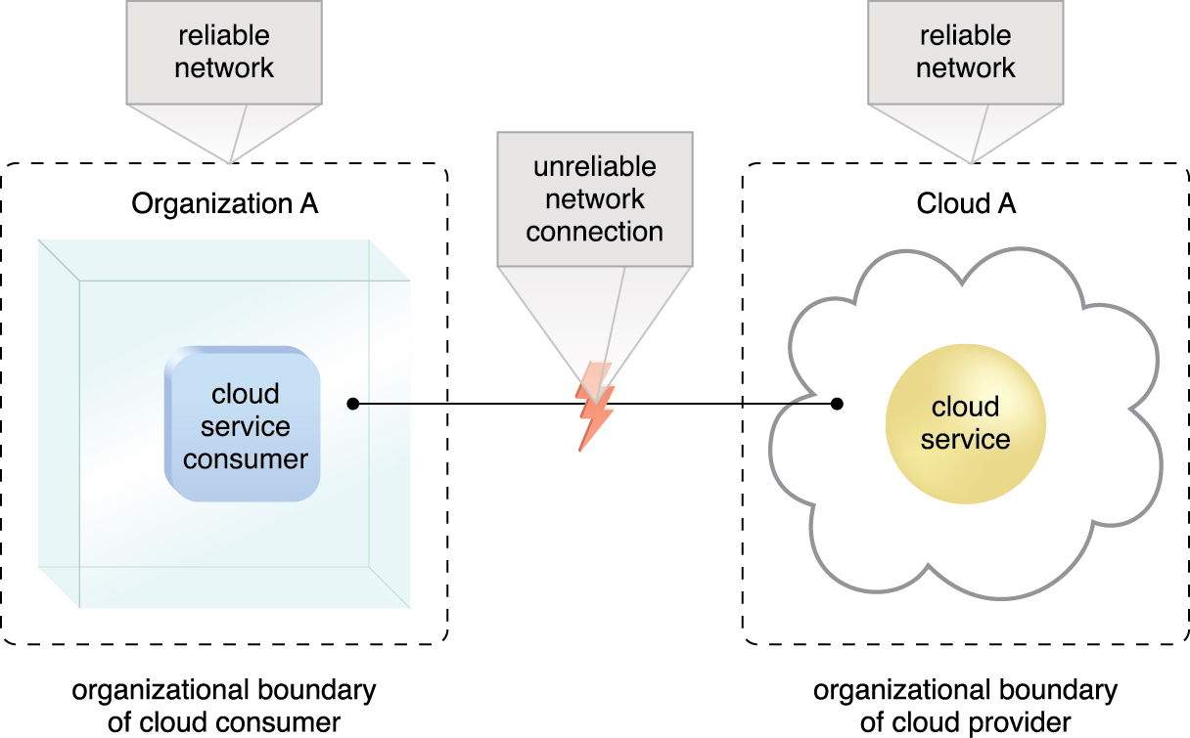
An unreliable network connection compromises the quality of communication between cloud consumer and cloud provider environments.

Slide 39
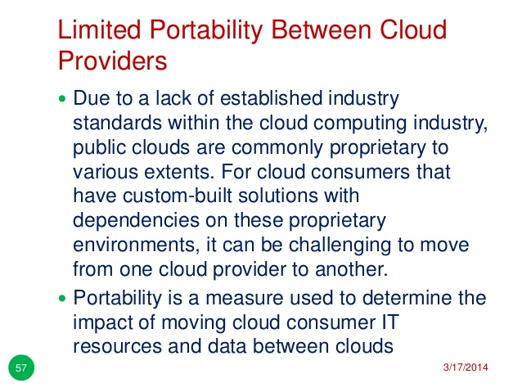

Slide 40
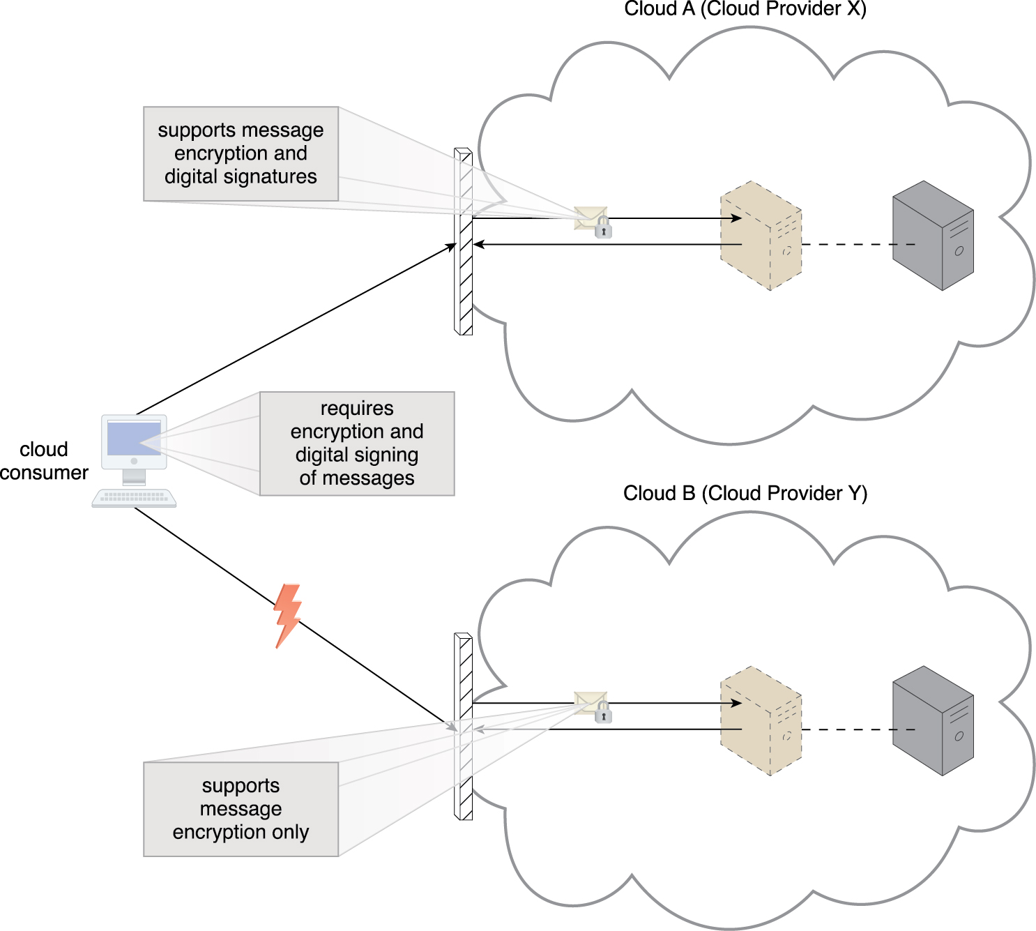
A cloud consumer’s application has a decreased level of portability when assessing a potential migration from Cloud A to Cloud B, because the cloud provider of Cloud B does not support the same security technologies as Cloud A.

Slide 41
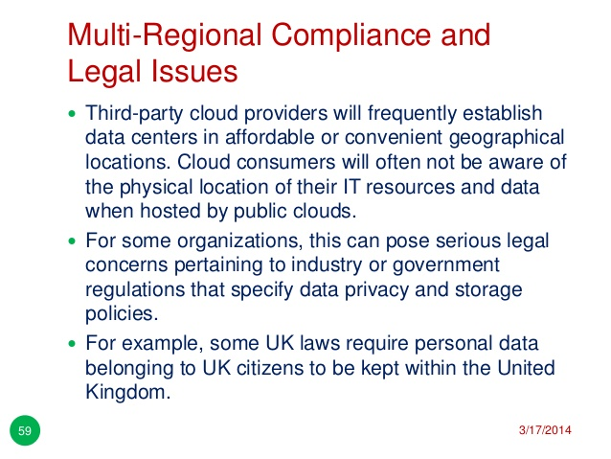

Slide 42
